Slide 1



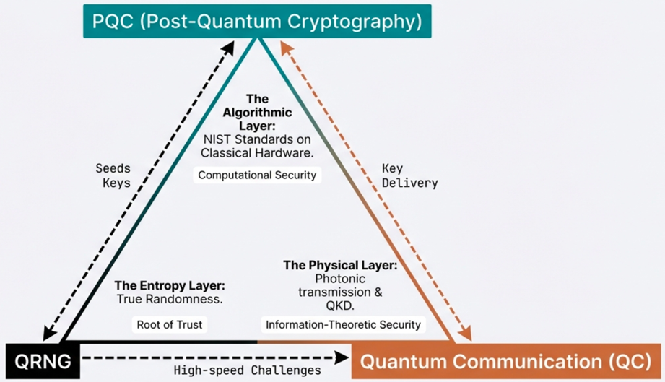
EgQCC Quantum Security Track
Quantum Security Foundation

Slide 2
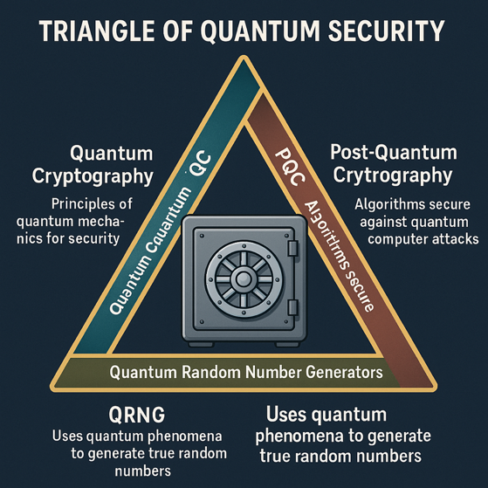
Triangle of Quantum Security (QC + PQC + QRNG)
Security Dimension | Quantum Communications (QC) | Post-Quantum Cryptography (PQC) | Quantum Random Number Generators (QRNG)
Principle | Uses principles of quantum mechanics for security (Quantum Communications) | Develops algorithms secure against quantum computer attacks | Uses quantum phenomena to generate true random numbers
Technology | Requires quantum hardware (e.g., QKD systems) | Can be implemented on classical computers | Based on quantum mechanical processes (e.g., photon behavior)
Examples | Quantum Key Distribution (QKD) like BB84, E91, … etc. | Lattice-based (Kyber, Dilithium), Code-based (McEliece), Hash-based (SPHINCS+) | Devices generating true randomness from quantum states of particles
Example (Bank Vault) | Super secure one-time delivery of the combination code (key) for the vault | Replacing the existing lock on the vault with a new, resistant to quantum computers | Generating true random numbers for the combination code (keys) using photons

Slide 3
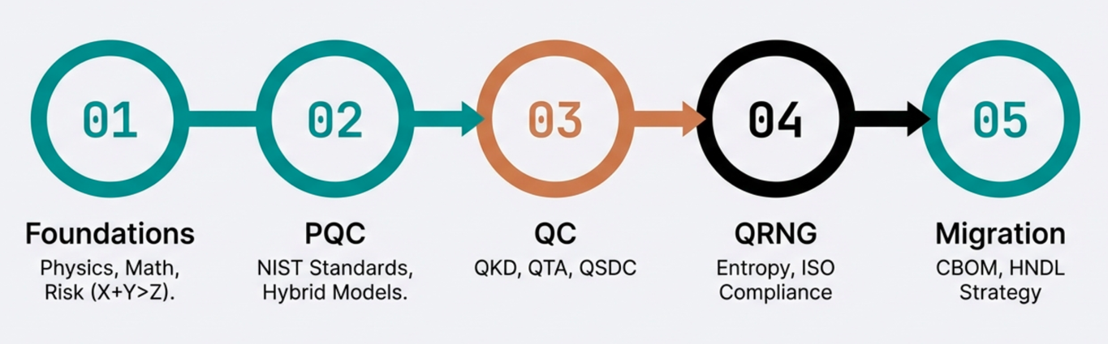
EgQCC Quantum Security Track

Slide 4
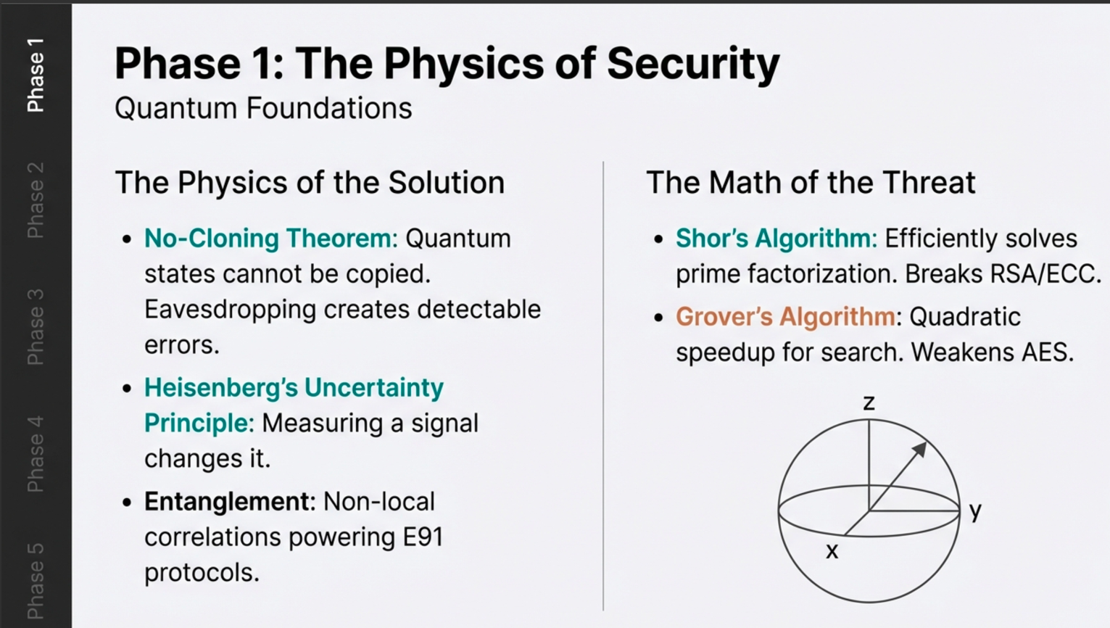

Slide 5
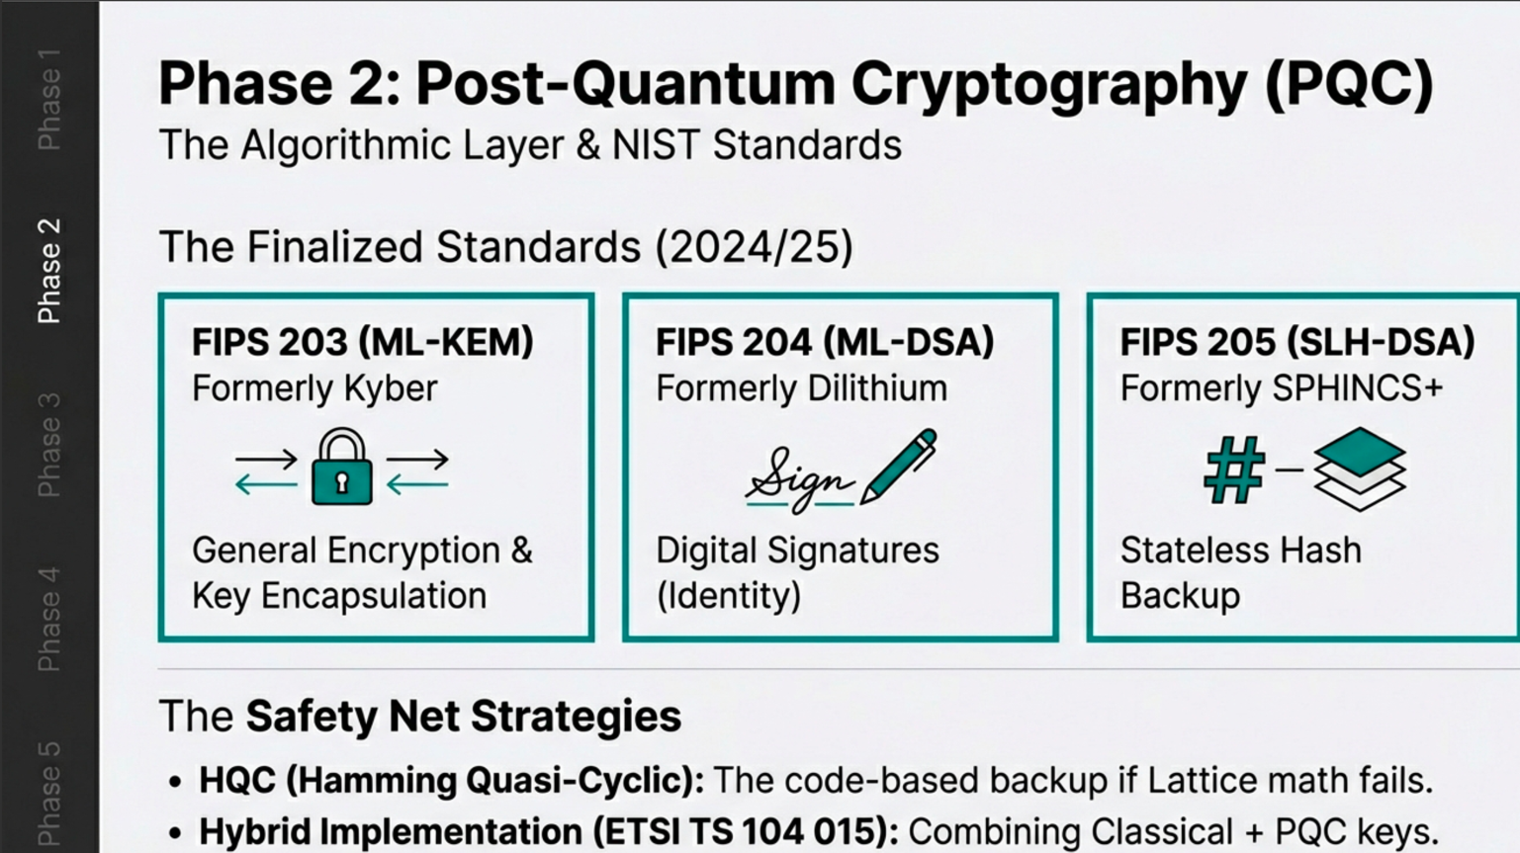

Slide 6
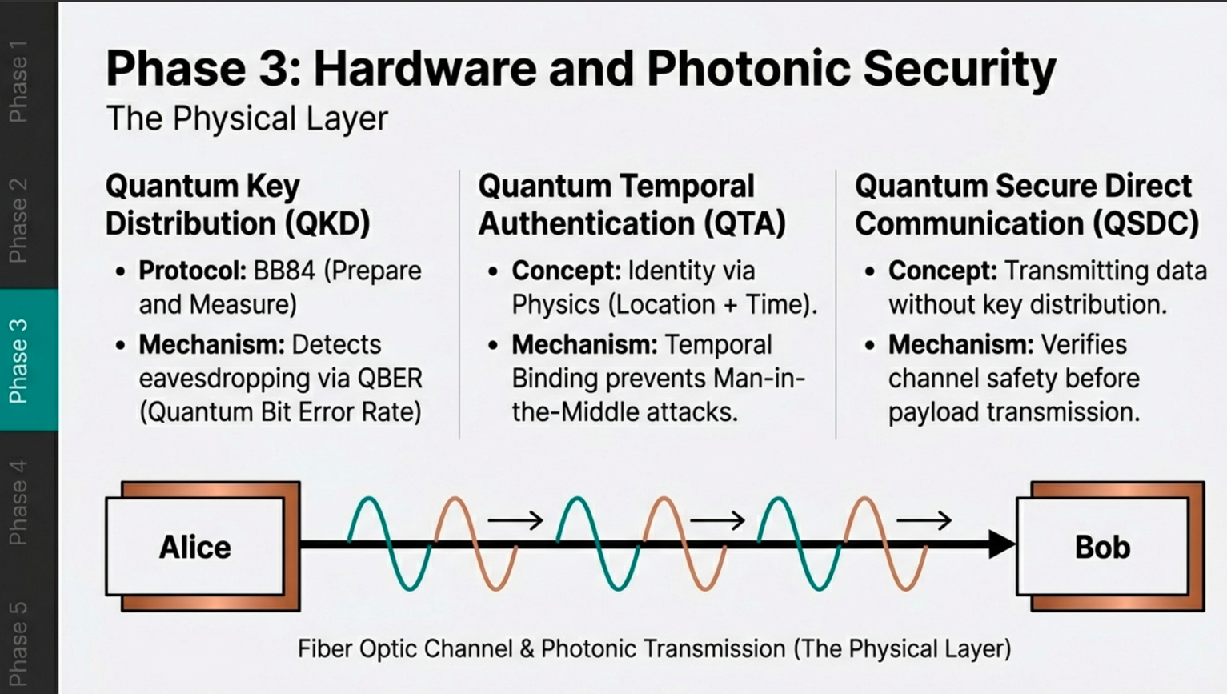

Slide 7
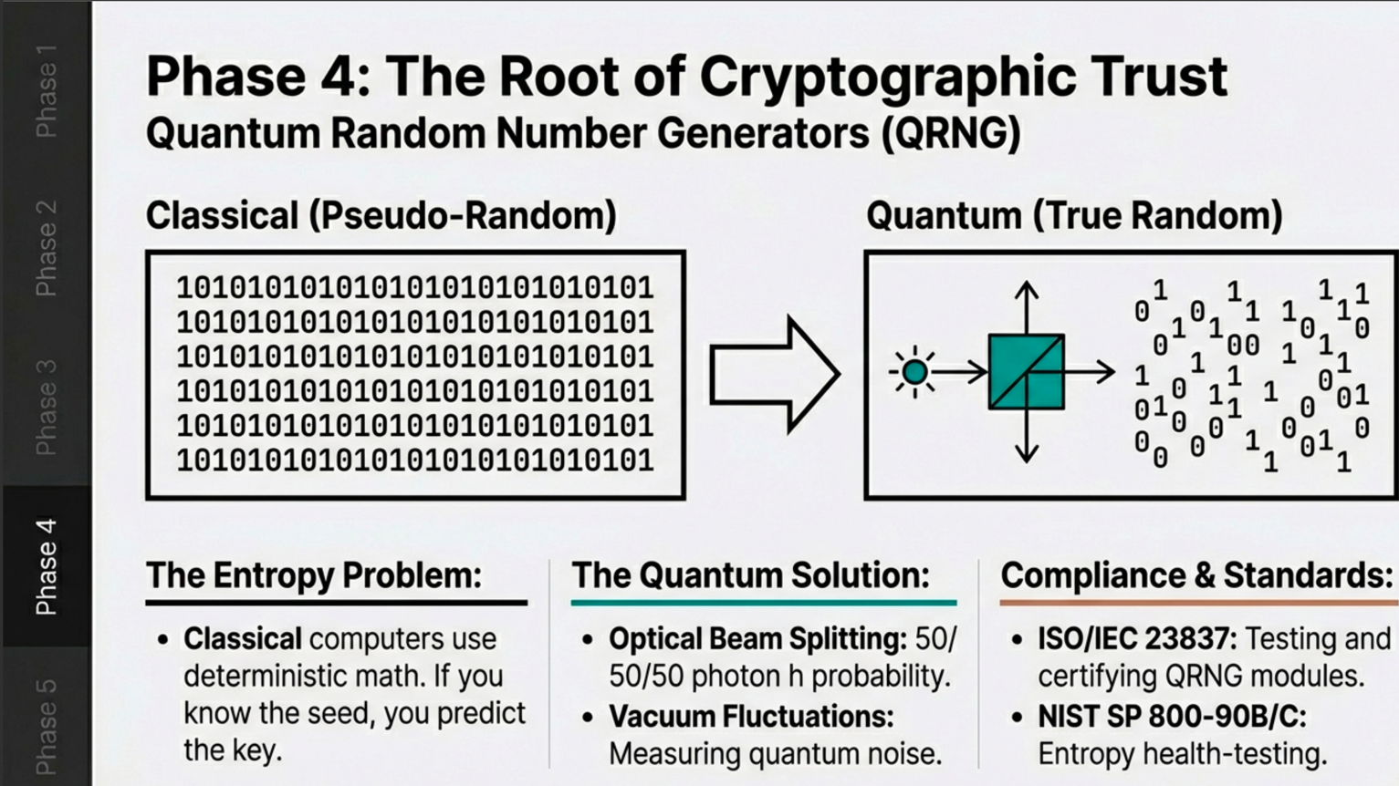

Slide 8
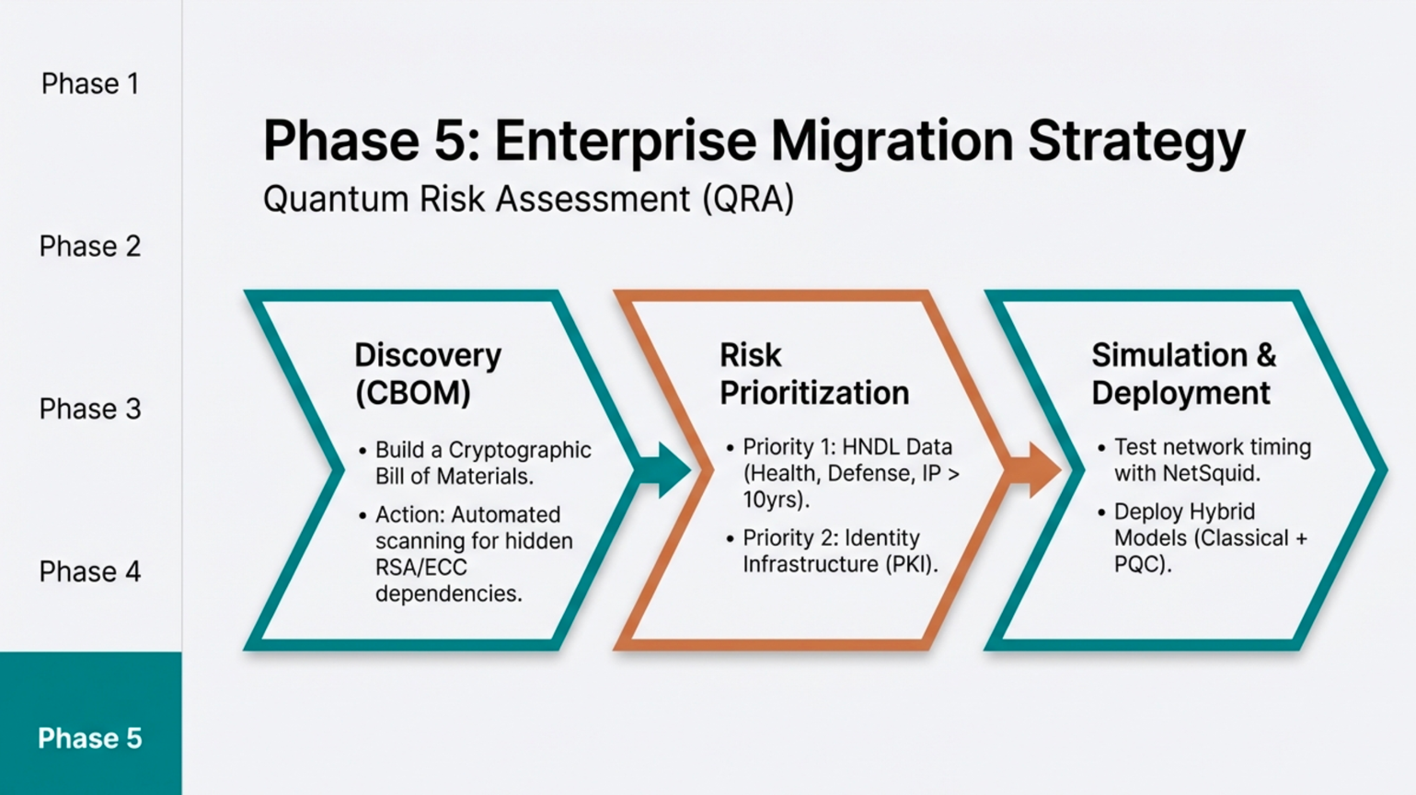

Slide 9

Q-Day (Quantum Day)
On Ocober 14th, 2024
Chinese researchers have successfully used a D-Wave quantum computer to breach AES encryption algorithms, signaling a new era of risk for critical sectors like banking and the military. This marks the first-ever quantum attack on military-grade encryption, showing how even our best defenses—like AES encryption—could be vulnerable.
Note: Shor’s Quantum algorithm (RSA) was published on 1994 (30+ years).
https://quantumzeitgeist.substack.com/p/researchers-hack-military-grade-encryption?utm_campaign=post&utm_medium=web&triedRedirect=true

Slide 10
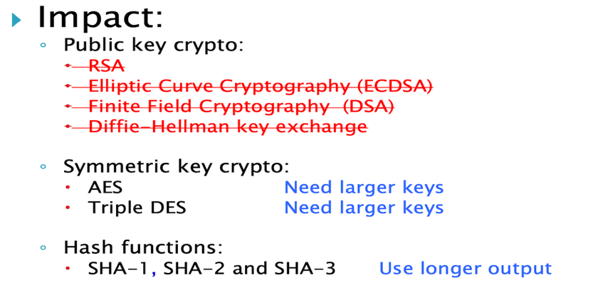
NIST Post-Quantum Cryptography Standardization (2016) https://en.wikipedia.org/wiki/NIST_Post-Quantum_Cryptography_Standardization

Slide 11
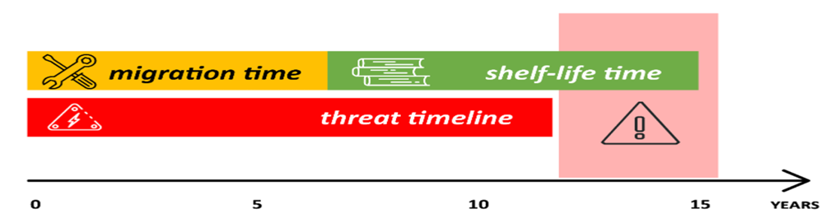
Problem Statement – Cybersecurity Threats of Quantum Computing
Cryptographically Relevant Quantum Computers (CRQCs) are emerging rapidly (Q-Day).
Their increasing capacity (measured by qubits) and development pace pose a significant risk on current Cybersecurity.
These quantum systems can decrypt widely used asymmetric security protocols like RSA or Elliptical Curve algorithms, or AES (just few months ago).
Migration and secrecy maintenance time exceed the expected arrival time of CRQCs
New legal regulations and directives are established in the US, EU, and China to address cryptographic concerns.
Mosca Theorem (x + y > z)

Slide 12
History of Cryptographic Transitions
Period | Event
1970s | Transition to NIST DES from proprietary algorithms
Early 1990s | RSA with 1024-bit keys, MD5, SHA1 widely used
Mid-1990s | Transition from DES to 3DES as AES was being developed
Early 2000s | MD5 found weak; industry moved to SHA1
2001 | AES published, but 3DES still widely used
2002 | NIST published SHA2 suite due to SHA1 concerns
2012 | RSA 1024 → 2048-bit transition
2017 | Google announced SHA1 collision
2020 | RSA-250 (829-bit) was factored; urged shift to 2048-bit
2022 | NIST Round 3 post-quantum algorithm selections announced
2024 | NIST published first tranche of quantum-resistant standards and algorithms (FIPS-203, FIPS-204, FIPS 205)
Q-Day | Shor’s Algorithm (1994) expected to break RSA, DH, ECC AES as well (October 2024)

Slide 13
Quantum-Resistant Standards for New Cryptographic Algorithms
Region / Body | Organization | Key Initiatives & Standards | Notable Algorithms Specifications
United States | NIST (National Institute of Standards and Technology) | PQC Standards - FIPS 203: ML-KEM (Kyber) - FIPS 204: ML-DSA (Dilithium) - FIPS 205: SLH-DSA (SPHINCS+) | ‘-ML-KEM (Kyber): Key encapsulation - ML-DSA (Dilithium): Digital signatures - SLH-DSA (SPHINCS+): Stateless hash-based signatures
European Union | ETSI (European Telecommunications Standards Institute) | Quantum-Safe Cryptography (QSC) - ETSI TS 104 015: Efficient Quantum-Safe Hybrid Key Exchanges with Hidden Access Policies | Covercrypt: Hybrid key encapsulation mechanism with access control
 | ENISA (European Union Agency for Cybersecurity) | PQC standardization and integration | Frameworks for PQC adoption and migration strategies
China | National Cryptography Administration (NCA) | National PQC standardization - Development of quantum-resistant algorithms | Proprietary algorithms under evaluation (not publicly disclosed)
 | Institute of Commercial Cryptography Standards (ICCS) | PQC Evaluation based on security, performance, and feasibility | Ongoing selection process for suitable algorithms
Middle East | - KSA: NCA (National Cybersecurity Authority) - NCS-2:2025 - UAE: UAECSC (Cyber Security Council) National Encryption Policy - Qatar: NCSA (National Cybersecurity Agency) - Strategy 2024–2030 | - KSA: Dec 2025 – Q2 2026: Mandatory submission of PQC Risk Assessments and "Advanced" level crypto-inventories for CNI - UAE: May – July 2026: Entities must submit PQC Migration Plans within 180 days of regulatory "Phase 0" notification. - Qatar: end of 2026: Modernization of financial sector PKI to support hybrid PQC/classical algorithms. | NIST Baseline: ML-KEM (Kyber), ML-DSA (Dilithium). NCS-2 Requirement: "Advanced" level systems must support Crypto-Agility and hybrid key exchange (e.g., X25519 + ML-KEM). Sovereign PQC: TII-optimized versions of ML-KEM/ML-DSA. Spec: Mandatory use of UAE-accredited libraries for "Priority Entities" to ensure digital sovereignty. Hybrid Resilience: Emphasis on dual-signature schemes and QKD (Quantum Key Distribution) for critical fiber backbones in the financial sector.

Slide 14
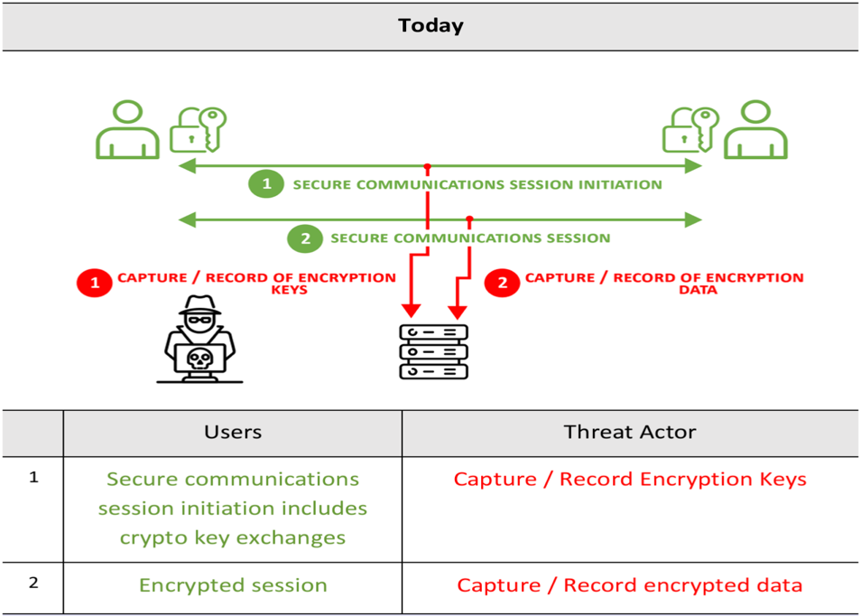
Threat Actor Today: Harvest Now, Decrypt Later

Slide 15
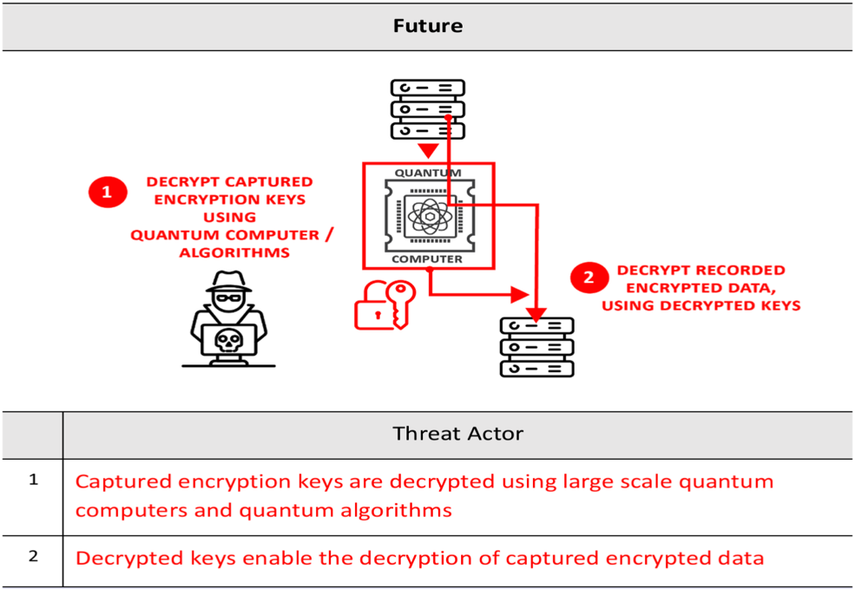
Threat Actor Future (Q-Day)

Slide 16
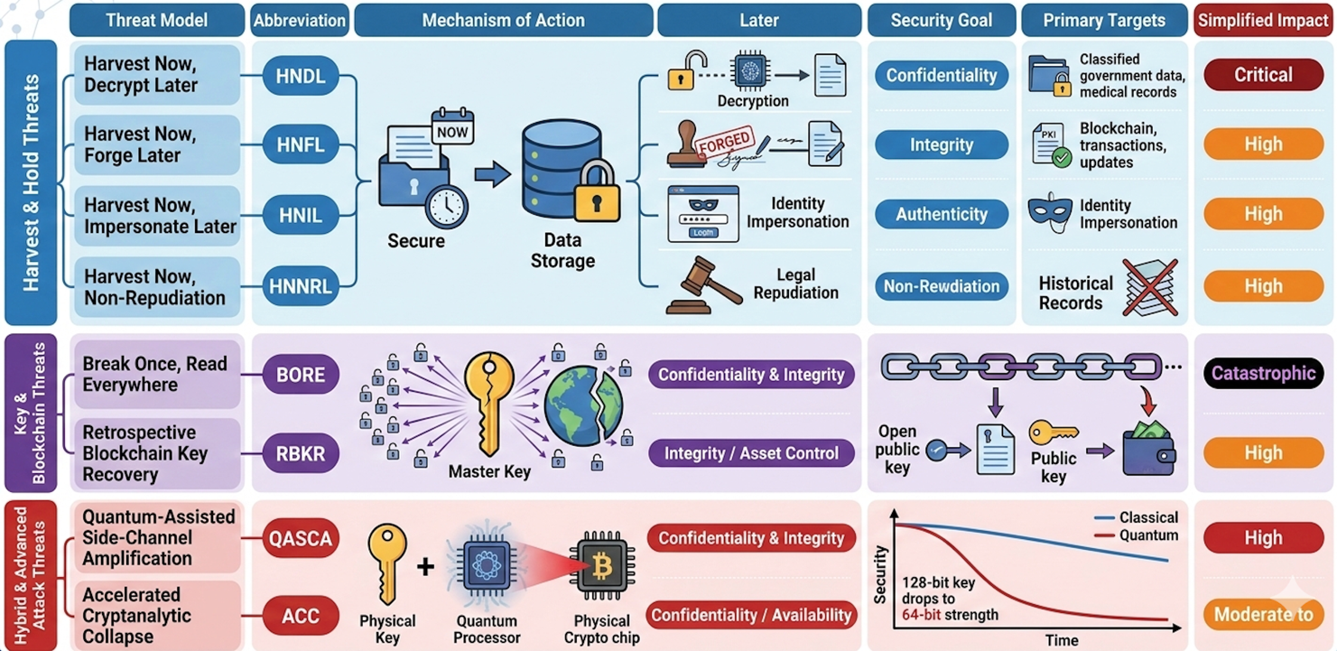
Quantum Threat Models

Slide 17




Projected Timelines and Expert Warnings
US Mandate
Expert Predictions
2035
2029
Gartner Warning
Classical cryptography unsafe from quantum attacks
White House Deadline
2030+
Expert Consensus
Tangible quantum threat emerges
2030
Germany BSI Assumption
Federal Systems Transition
Quantum computers break today's algorithms
Quantum-Resistant Cryptography
Government Mandate Compliance

Slide 18







Core Mathematical Foundations
Lattice-Based
Hash-Based
Code-Based
SVP Problem
Pre-Image Resistance
Error-Correcting Codes
Shortest Vector Problem
Cannot find input from output
Mathematical complexity
LWE Problem
Collision Resistance
McEliece System
Learning With Errors
No two inputs same output
Classic encryption scheme
ML-KEM & ML-DSA
SLH-DSA
40+ Years
Primary NIST standards
High-assurance security
Unbroken security record
Quantum-Resistant
Well-Understood
High Assurance
Hard for quantum computers
Extensively studied
Proven security track record

Slide 19






Hybrid vs. Pure PQC Debate
Pro-Hybrid
Non-Hybrid
Safety Net
Performance Overhead
Connection remains secure if one algorithm is unbroken
Increased complexity slows adoption
Daniel J. Bernstein
Resource Requirements
Prominent cryptologist advocating for hybrid models
Larger keys and signatures impact constrained systems
Risk Mitigation
NIST Position
Many PQC proposals have been broken by researchers
Standards are non-hybrid, NSA guidance supports direct transition
Allegation
Industry Practice
NSA and GCHQ pressured NIST to exclude hybrid approaches
AWS and others starting with hybrid as transitional step

Slide 20








Key Implementation Challenges
Performance & Size
IoT & Embedded
Crypto-Agility
Long Lifecycles
Easy Switching
Larger Keys
10-20 years device lifespan
Replace algorithms seamlessly
Public & private key sizes increased
Limited Resources
Quick Migration
Larger Signatures
Constrained computational power
Rapid algorithm transitions
Digital signature overhead
No Update Mechanism
Legacy Systems
Bandwidth Impact
No practical upgrade path
Many lack this capability
Increased data transfer
Difficult to Upgrade
Complex Engineering
Slower TLS Handshake
Hardware redesign required
Costly migration effort
Connection delays
Legacy vulnerabilities
Essential requirement
Resource intensive
Strategic Migration
Performance Testing
Vendor Engagement
Phased transition approach
Evaluate impact early
Ensure supply chain readiness

Slide 21



Five Stages of Quantum Adoption
1
Denial
2
Bargaining
3
Anger
View quantum as distant or irrelevant
Acknowledge threat but deprioritize
Realize transition is complex
Consider threat alarmist
Focus on AI, cloud, other projects
Frustration among security teams
Only 5% prepared
"We'll deal with it later"
More complex than anticipated
4
Depression
5
Acceptance
Overwhelmed by scope: tens of thousands of certificates
Shift from reactive to proactive stance
Create comprehensive action plan
Budget constraints
Invest in resilience, trust, and agility
Unprepared third-party vendors
Ready to lead quantum readiness
Scale feels insurmountable
Emotional and operational hurdles enterprises face during PQC adoption

Slide 22







Recommended Action Plan for Enterprises
1
Cryptographic Inventory
2
Pilot PQC
3
Upgrade Protocols
Non-Production Environment
Modernize TLS Stack
Discover & Catalog
Test PQC certificates and algorithms
Transition to TLS 1.3
All cryptographic assets across enterprise
Assess Performance
Better PQC Support
Algorithms & Certificates
Evaluate overhead and impact
Designed for quantum resistance
Create comprehensive risk overview
Interoperability Testing
Enhanced Security
Cryptographic Bill of Materials
Verify integration capabilities
Improved encryption capabilities
CBOM for strategic assessment
Foundation for migration
Validate before deployment
Build strong foundation
4
Engage Vendors
5
Migration Roadmap
Hardware Suppliers
Strategic Assessment
Consult PQC roadmaps and timelines
Prioritize critical and long-lived data
Software Partners
Clear Budget Allocation
Understand vendor readiness
Resource-intensive migration effort
Supply Chain Preparation
Phased Implementation
Ensure entire ecosystem ready
Upgrade or replace vulnerable components
Align all stakeholders
Execute quantum readiness

